Slide 1
Secure Data Hiding In Images Using Steganography
CAPSTONE PROJECT
Presented By: Chapala Sai Varsha
Student Name : Chapala Sai Varsha
College Name & Department : Malla Reddy Engineering College/CSE CS

Slide 2
OUTLINE
Problem Statement
Technology used
Wow factor
End users
Result
Conclusion
Git-hub Link
Future scope

Slide 3
Problem Statement
With the rise in digital communication, ensuring secure data transmission is crucial. Traditional encryption methods may attract attention, making data susceptible to attacks. This project, Secure Data Hiding in Images Using Steganography, focuses on embedding sensitive information within images, ensuring privacy and undetectability. By leveraging cryptographic techniques and steganography, this system provides a secure and efficient method for covert communication.

Slide 4
Technology used
Programming Language:
Python – Core language for implementation
Libraries & Tools:
OpenCV – Image processing and manipulation
NumPy – Handling image arrays and computations
PIL (Pillow) – Image reading and writing
Cryptography (Fernet) – Encryption and decryption of hidden messages

Slide 5
Wow factors
1️⃣ Dual-Layer Security – Unlike basic steganography, this project combines image-based data hiding with cryptographic encryption (Fernet), ensuring double protection. Even if someone extracts the hidden data, they still need the correct decryption key!
2️⃣ Lossless Data Hiding️ – The original image quality remains intact after embedding the secret message, preventing suspicion or detection.
3️⃣ Multi-Format Support – Works with PNG, JPG, and other common image formats, making it highly versatile.
4️⃣ Custom Key Protection – The encryption is secured with a user-defined key, ensuring that only authorized individuals can retrieve the hidden information.
5️⃣ Lightweight & Fast Processing – Optimized with NumPy and OpenCV for quick encryption and decryption, even on large images.

Slide 6
End users
Cybersecurity Experts
Intelligence Agencies
Journalists
Corporations
Forensic Investigators
Privacy Enthusiasts

Slide 7
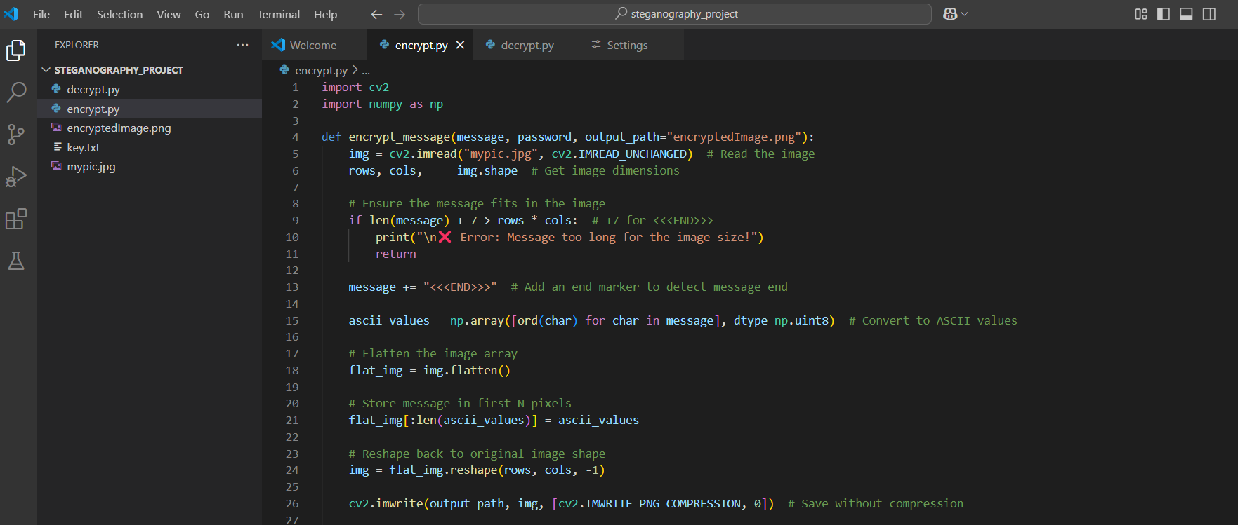
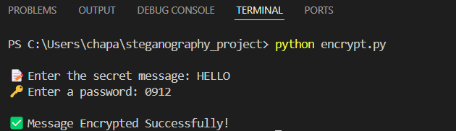
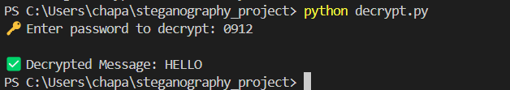
Results

Slide 8
Conclusion
Secure Data Hiding in Images Using Steganography provides a reliable solution for covert communication and data security.
Sensitive information is embedded within images, making it undetectable to unauthorized users.
The combination of cryptographic encryption and steganography enhances security, ensuring only authorized users can retrieve the data.
Lossless image processing ensures that the image quality remains unchanged after embedding the message.
This project offers a practical and efficient approach for secure digital communication across various fields.

Slide 9
GitHub Link
https://github.com/varshareddy1209/Secure-Data-Hiding-in-Images

Slide 10
Enhanced encryption techniques by integrating advanced cryptographic algorithms for stronger security.
Support for multiple file types, expanding beyond images to hide data in audio, video, and document files.
AI-based detection resistance by implementing machine learning techniques to evade forensic analysis.
Cloud and web integration to develop a real-time secure data hiding and retrieval system accessible from anywhere.
Future scope(optional)

Slide 11
THANK YOU

